Slide 1
Your contribution title
First Name Surname
Company, Country
Subtitle

Slide 2
Heading (24 pt)
Heading 2 (20 pt)
  Content (16 pt)
  Example 1 (16 pt)
  Example 2
please go to “View” → “Slide Master”
to change your details here and to set your own logo

Slide 3
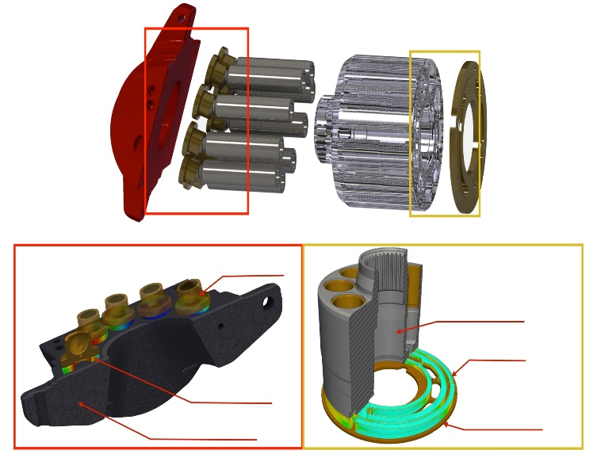
Lifetime Extension of Axial Piston Pumps by Means of Simulation and Measurements
Roman Ivantysyn
IMD, TU Dresden, Germany
Slipper / Swash Plate
Cylinder Block / Valve Plate
Slipper
Cylinder
Block
Fluid Film
Fluid Film
Valve
Plate
Swash Plate

Slide 4
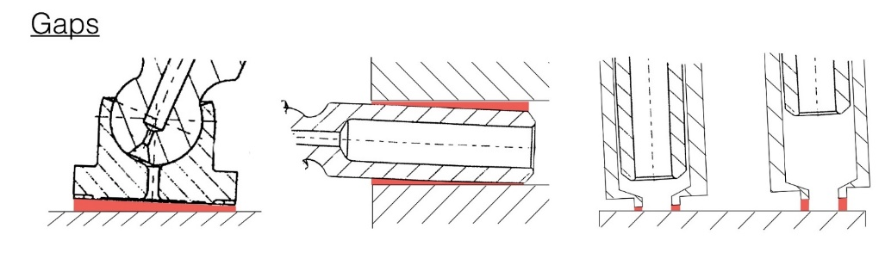


Introduction
Research Topic
Gap heights
  Research Topic
Investigation of lifetime critical effects in swash plate type axial piston pumps
Simulation of the physical effects in the lubricating gaps
Measurement of temperature distribution, gap height and local pressures
  Objective
Locate relevant points for gap, pressure and temperature sensors to be placed in an experimental set up called “transparent pump”
Pressure distribution
Temperature distribution

